Slide 1

Git Good!
Presented by QC Coders

Slide 2
What is Git?
Git is a distributed version-control system for tracking changes in source code during software development.
Git was created by Linus Torvalds in 2005 for development of the Linux kernel.

Slide 3
What?

Slide 4
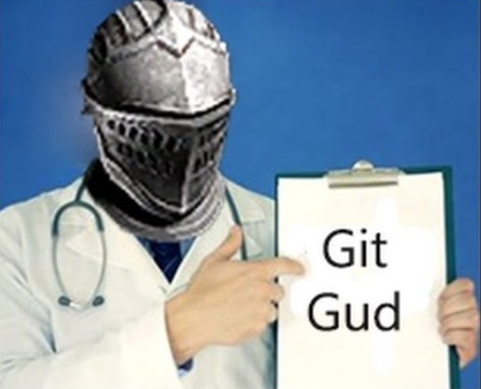
What?

Slide 5
What?
Git is storage for text based files
Files are stored in a “repository”, which is a fancy name for a folder on your computer, with some extra hidden files inside of it
Git tracks changes to files in an incremental fashion
Instead of keeping both copies of a modified file, git computes the difference between the old and new files and stores that.
Git keeps all history forever, and allows you to:
See a log of all changes, additions and deletions to both files and contents of files
Go back to a previous point in time
See the differences between any two points in time
Git allows you to synchronize your repository with a central repository

Slide 6
Why?
File backup
Review differences between versions
It worked last Tuesday, but today it’s broken. What changed?
Collaboration
Easily review changes made by others
Easily assign blame when something goes wrong
Share changes!

Slide 7
What’s So Special About Sharing?
Because Git saves file changes incrementally, it can easily handle changes made to different parts of a file, updated at the same time
Other version control systems overwrite files as a hole, which might cause changes to be lost
Example:
Bob and Alice both download a copy of a file on Tuesday
Bob updates his copy of the file Tuesday, but doesn’t upload it
Alice updates her copy of the file Wednesday and uploads it
Bob uploads his copy Thursday
What happens to Alice’s changes?
Git will merge the contents of both copies, and nothing is lost!

Slide 8
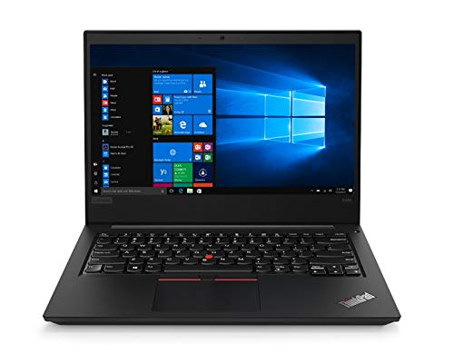


Slide 9
Questions?

